Slide 1


ELO Forms
Stefan Nesbigall
Team Leader Mobile Clients ELO Digital Office
Philipp Dempfle
Produktmanager ELO Digital Office

Slide 2


Agenda
1
Overview
2
ELO Forms
3
Questions/discussion
4
Summary

Slide 3
ELOwf forms: Current problems
(One of) the first ELO web developments.
No JS framework, just plain scripts.
Cluttered, old code base.
No separation between description and implementation
JSP frame file and templates, arbitrary customization possible.
Static, non-responsive layout.
Hard to change, refactor or extend and maintain backwards compatibility.
1
Overview

Slide 4
Vision
Support of the new data model with metadata and aspects
Different (technical) views for aspects
New Form Designer
Responsive design, so that the forms are usable on the Windows desktop as well as on a smartphone/tablet
1
Overview
Notes:
Andere Präsi:
Ist-Stand – Warum?
Exportieren
Einfrieren von Status
Historisierung von Daten
Vorteile von Metadaten und Aspekten und neuer Struktur → EIM

Slide 5
Aspects
Aspect
New data model (in brief)
Person
New organization of metadata.
Objects (forms) hold relations to aspects.
Aspects consist of several lines of data.
FIRSTNAME first name Text
LASTNAME last name Text
POSITION position Text
Object
Contact
Contact Person
Private Address
Business Address
1
Overview

Slide 6
Parallel solution
ELOwf forms are widely used (nearly every project).
Business solutions highly depend on ELOwf forms.
ELOwf forms will stay around for several years.
ELOwf forms will be used for current data model (old masks).
ELO Forms will be used for aspect data model (new masks).
1
Overview

Slide 7
Agenda
1
Overview
2
ELO Forms
3
Questions/discussion
4
Summary

Slide 8
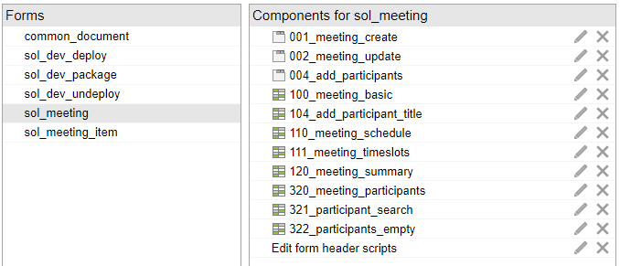
Description of a form
ELOwf forms: Good templating system.
ELO Forms:
A form is a composition of templates.
A template is a composition of fields.
2
ELO Forms

Slide 9
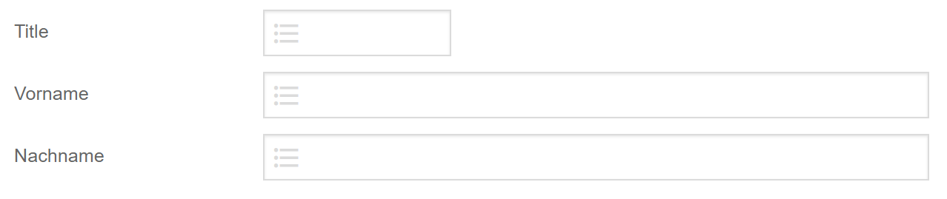
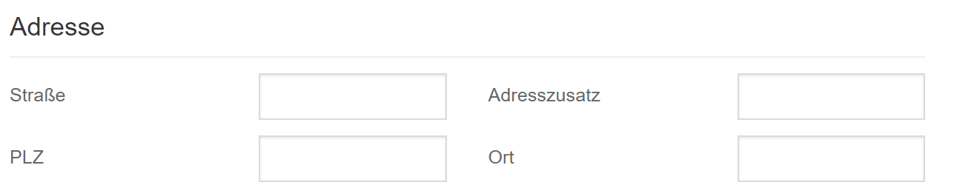
Aspect
Object
Person
FIRSTNAME first name Text
LASTNAME last name Text
POSITION position Text
Contact
Contact Person
Private Address
Business Address
compact
Template person.default
default
default
Form
Template person.compact
2
ELO Forms

Slide 10
Format of the form description
ELOwf forms: bad definition format (jsp/html snippets).
ELO Forms:
Forms, templates and fields are described in JSON.
The definition is separated from the implementation and appearance.
JSON is extensible.
„Just a matter of implementation.“
<tbody id="eloedit" tableid="tb" bigtable="false" tablebreak="false" eloelems=""><tr><td class="" style="">
<div elonodename="TEXT" style="left: 0px; top: 0px;" id="">
<elowf:text>myTextField</elowf:text></div></td>
<td class="">
<div elonodename="INPUT">
<input type="text" size="20" name="IX_MAP_CONTACT_FIRSTNAME" value="" title="" eloverify="" accesskey="">
</div></td>
</tr></tbody>
main: {
is: "elo.forms.Section",
config: {
content: [{
is: "elo.forms.field.Text",
config: {
label: "myTextField",
name: "aspect.contact.FIRSTNAME",
}],
}
}
2
ELO Forms

Slide 11
Form definitions
Collection of available fields and layouts.
Holding implementation specific information to create the components that represent this field.
Closing the gap between description and implementation.
Support the designer to create an abstract description.
main: {
is: "elo.forms.Section",
config: {
content: [{
is: "elo.forms.field.Text",
config: {
label: "myTextField",
name: "aspect.contact.FIRSTNAME",
}],
}
}
2
ELO Forms

Slide 12
Implementation
+
Abstract form descriptions
Form definitions
Separation of concerns
Description is separated from implementation.
Form components: UI frontend to visualize the state of the form and provide user interaction.
Headless JS form: To manage/validate the state/lifecycle of the form.
Specific form description
Form components
Headless JS form
2
Forms 2

Slide 13



Implementation
New web development stack
Vue.js as new framework for all web frontends.
CSS framework Bulma
Buefy components
https://vuejs.org/
https://bulma.io/
https://buefy.org/
2
Forms 2

Slide 14
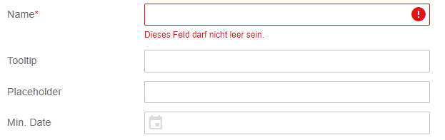
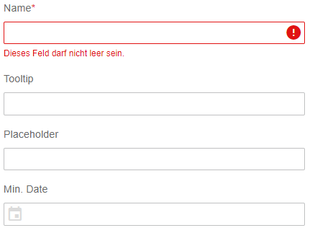
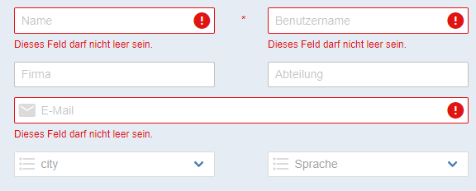
Appearance
Customized Bulma theme
Responsive
Predefined column layouts
2
ELO Forms

Slide 15
Architecture
Server
Browser
Form app
Vue.js App
Abstract form descriptions
JSON format
Incl. initial values
Incl. localizations
Forms IX Plugin
Rest API
Caches
Read/save forms/templates
Read/save form data
Keyword lists
Localization
FormService
Managing lifecycle
Lifecycle scripting (beforeSave)
Read/save data to/from server
JavaScript
Form definitions
Transformations
Form components
UI components
Component/event scripting
Vue.js
components
Specific form description
JS objekt
Specific to component implementation
Extendable
Headless JS form
Manages form value
Validations
Formular scripting
Dirty fields
JavaScript
2
ELO Forms

Slide 16
Scripting & Customization
No arbitrary scripting.
Only on predefined events using a predefined API.
No access to global variables (window, document).
Event script is stored (as string) along with the form/field.
API can be extended by custom helper functions.
2
ELO Forms

Slide 17
Summary
Das neue Metadaten-Model sowie die neuen Formulare werden vorerst parallel zum bestehenden Betrieb funktionieren
2
ELO Forms

Slide 18
Questions?

